Slide 1
Snowflake Module 4
Fern Pombiero
Credentials

Slide 2

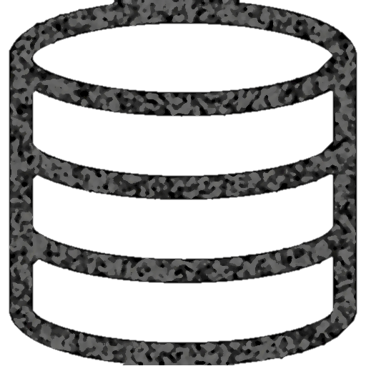
Snowflake Data Warehouse
Authentication and Access Control
Cloud
Services
Infrastructure Manager
Optimizer
Transaction Manager
Security
Virtual Warehouse
Virtual Warehouse
Virtual Warehouse
Query
Processing
Database
Storage
Notes:
Should be a review from previous days

Slide 3
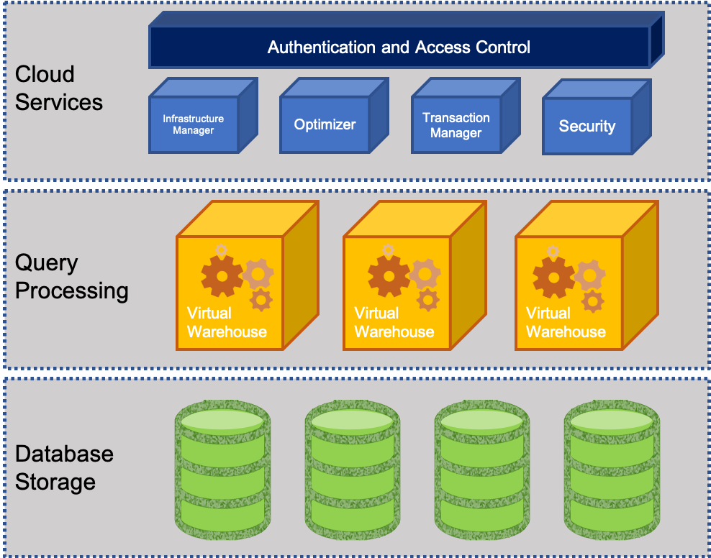
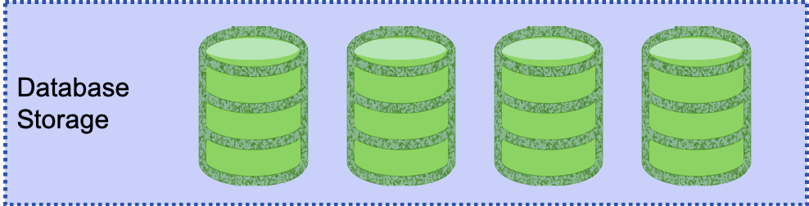
Efficient data storage in Snowflake Database Storage Layer
The storage layer contains tables, schemas, databases, and diverse data
If managed well storage layer can hold petabytes of data
Snowflake has scalable cloud blob storage type for storing structured and semi-structured data
Such as JSON, AVRO, and Parquet
Snowflake optimizes the metadata for easy extraction and query processing
Storage is made up of multiple micro partitions that are encrypted and scale automatically
Allows for efficient data retrieval and performance
Notes:
Should be a review from previous days

Slide 4
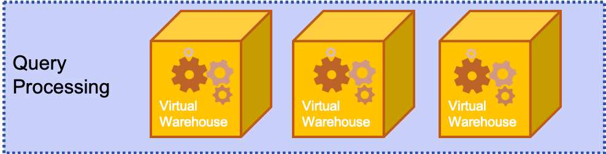
Efficient data storage in Snowflake Query Processing Layer
This layer contains virtual warehouses where all the queries are run on each respective virtual warehouse
Allows for a scalable compute capacity
Each Virtual warehouse gets data from the storage layer and has it cached to the compute resources
Multiple VW operate simultaneously to maintain ACID and follow multiple parallel processing
ACID (Atomic, Consistent, Isolated and Durable) that ensure a database management system (DBMS) will make changes to data in a reliable
VW can auto-suspend, auto-resume, and have auto-scaling that can be built in
Notes:
Should be a review from previous days

Slide 5
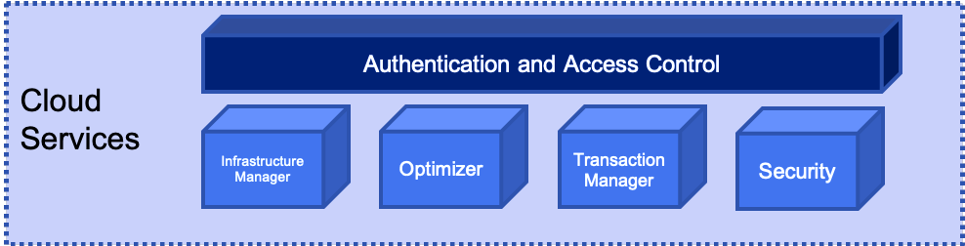
Efficient data storage in Snowflake Cloud Services Layer
This layer is the cerebrum of Snowflake where it maintains, optimizes, transacts on data, as well as provides security, and metadata management
Enables SQL client interface for DDL and DML like operations on data
VW can auto-suspend, auto-resume, and have auto-scaling that can be built in
Notes:
Should be a review from previous days

Slide 6

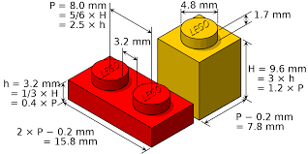
Understanding Micro-partitions vs Static partitions
Static partitioning - is used when the values for partition columns are known when loading data
Benefits
Works with data that is already known
Achieves acceptable performance and enables better scaling
Limitations
High maintenance cost to make changes
Data skew if partitions are not set up well
Disproportionately-sized partitions happen

Slide 7
Understanding Micro-partitions vs Static partitions
Micro partitioning – same value as static partitioning but removes the limitations
All data is Snowflake automatically divided into micro-partitions
Each micro-partition contains 50 MB – 500 MB of uncompressed data
(size is actually smaller since data is always stored compressed)
Groups of rows are mapped to individual micro-partitions and organized in columnar fashion
Allows for extreme granular pruning of large tables (millions of micro-partitions)
Benefits
Columnar Storage
Automatic
Efficient Scanning
Micro-partitions
Size is tiny
Overlapping Storage
DML
Notes:
Benefits
micro-partitions are derived automatically; do not need to be defined up-front or maintained by users.
micro-partitions are small in size (50 to 500 MB, before compression), which enables extremely efficient DML and fine-grained pruning for faster queries.
columnar storage - Columns are stored independently within micro-partitions
Columns are also compressed individually within micro-partitions.
Micro-partitions can overlap in their range of values, which, combined with their uniformly small size, helps prevent skew.
only the columns referenced by a query are scanned – efficient scanning
Snowflake automatically determines the most efficient compression algorithm for the columns in each micro-partition.
All DML operations (e.g. DELETE, UPDATE, MERGE) take advantage of the underlying micro-partition metadata to facilitate and simplify table maintenance. For example, some operations, such as deleting all rows from a table, are metadata-only operations.

Slide 8

Query Pruning
Snowflake enables precise pruning of columns in micro-partitions at query run-time, including columns containing semi-structured data
Date Hour Action Action_Category Feature Feature2 Feature3
1/1/2019
1/2/2019
.
.
.
.
.
7/14/2019
.
.
.
.
12/31/2019
1pm
12am
.
.
.
.
.
4pm
.
.
.
.
3am
xxxxx
yyyyy
.
.
.
.
.
zzzzz
.
.
.
.
www
xxxxx
yyyyy
.
.
.
.
.
zzzzz
.
.
.
.
www
xxxxx
yyyyy
.
.
.
.
.
zzzzz
.
.
.
.
www
xxxxx
yyyyy
.
.
.
.
.
zzzzz
.
.
.
.
www
xxxxx
yyyyy
.
.
.
.
.
zzzzz
.
.
.
.
www
1 year's worth of data
Notes:
a query that specifies a filter predicate on a range of values that accesses 10% of the values in the range should ideally only scan 10% of the micro-partitions
For example, assume a large table contains one year of historical data with date and hour columns. Assuming uniform distribution of the data, a query targeting a particular hour would ideally scan 1/8760th of the micro-partitions in the table and then only scan the portion of the micro-partitions that contain the data for the hour column;
Snowflake uses columnar scanning of partitions so that an entire partition is not scanned if a query only filters by one column.
the closer the ratio of scanned micro-partitions and columnar data is to the ratio of actual data selected, the more efficient is the pruning performed on the table.
Time series data allows for sub second response time
Not all predicate expressions can be used to prune. For example, Snowflake does not prune micro-partitions based on a predicate with a subquery, even if the subquery results in a constant.

Slide 9
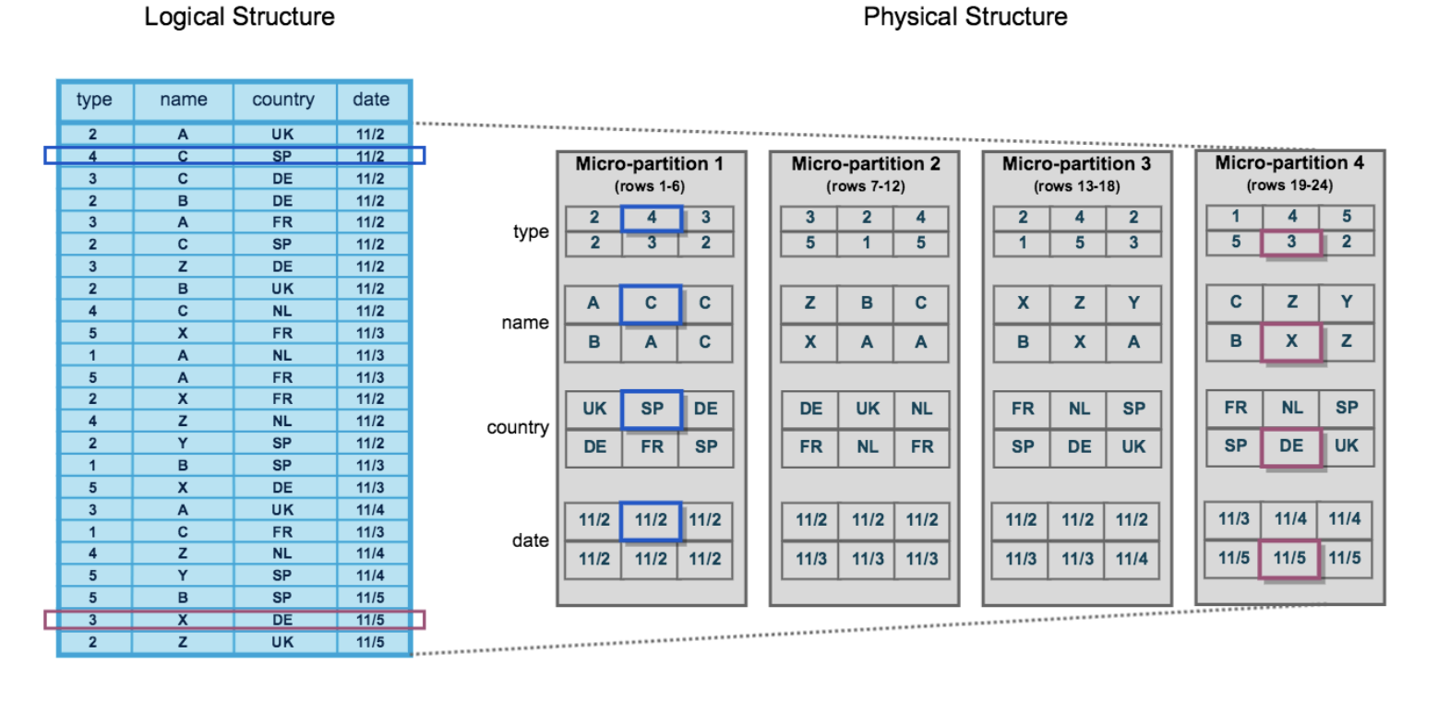
Data Clustering of Micro-Partitions
Clustering is a key factor in queries for unsorted tables which impacts query performance, particularly on very large tables
While Micro-Partitions data is stored in tables which is sorted/ordered along natural dimensions
e.g. date and/or geographic regions
Notes:
clustering metadata is collected and recorded for each micro-partition created during the process. Snowflake then leverages this clustering information to avoid unnecessary scanning of micro-partitions during querying, significantly accelerating the performance of queries that reference these columns.
The table consists of 24 rows stored across 4 micro-partitions, with the rows divided equally between each micro-partition. Within each micro-partition, the data is sorted and stored by column, which enables Snowflake to perform the following actions for queries on the table:
First, prune micro-partitions that are not needed for the query.
Then, prune by column within the remaining micro-partitions.
Note that this diagram is intended only as a small-scale conceptual representation of the data clustering that Snowflake utilizes in micro-partitions. A typical Snowflake table may consist of thousands, even millions, of micro-partitions.

Slide 10
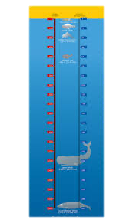
Data Clustering of Micro-Partitions
Snowflake maintains clustering metadata for the micro-partitions in a table, including:
The total number of micro-partitions that make up the table
The number of micro-partitions containing values that overlap with each other (in a specified subset of table columns).
The depth of the overlapping micro-partitions
Clustering Depth average depth (1 or greater) of the overlapping micro-partitions for specified columns in a table
Monitoring the clustering “health” of a large table, particularly over time as DML is performed on the table.
Determining whether a large table would benefit from explicitly defining a clustering key

Slide 11
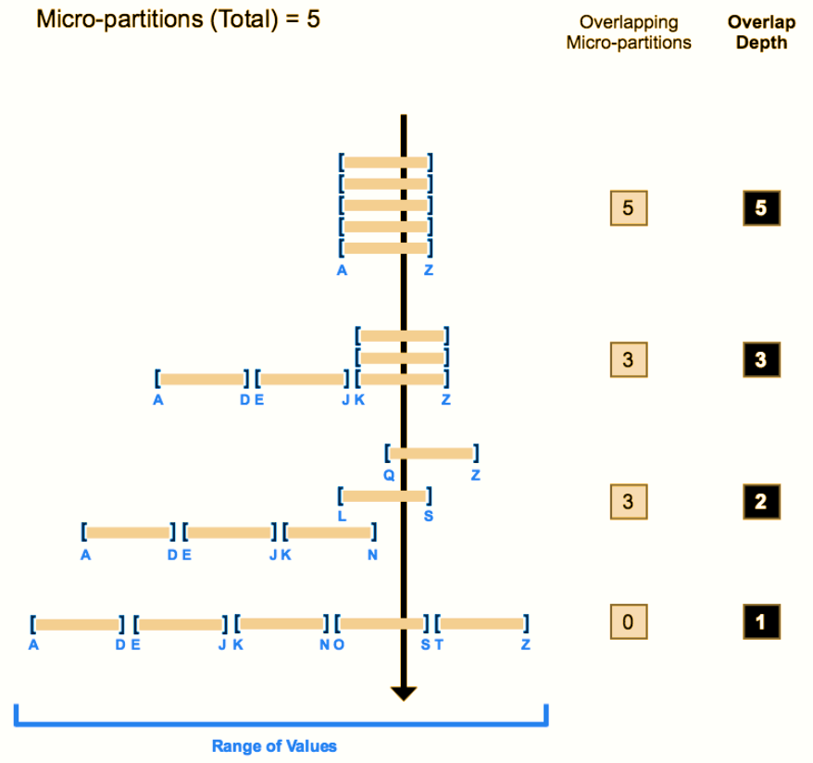
Data Clustering of Micro-Partitions
The line through shows the overlapping micro-partitions
The average depth shows how many overlap at any given moment
Clustering depth for a table is not an absolute or precise measure of a well clustered table
A well clustered table performs queries quickly
performance degrades if the table is likely no longer well-clustered
Notes:
The following diagram provides a conceptual example of a table consisting of five micro-partitions with values ranging from A to Z, and illustrates how overlap affects clustering depth:
As this diagram illustrates:
1. At the beginning, the range of values in all the micro-partitions overlap.
2. As the number of overlapping micro-partitions decreases, the overlap depth decreases.
3. When there is no overlap in the range of values across all micro-partitions, the micro-partitions are considered to be in a constant state (i.e. they cannot be improved by clustering).
The diagram is not intended to represent an actual table. In an actual table, with data contained in a large numbers of micro-partitions, reaching a constant state across all micro-partitions is neither likely nor required to improve query performance.

Slide 12




Clustering Keys
Clustering Keys can be used when DML takes place in large tables and snowflakes automatic clustering is no longer optimal
Re-inserting the data by manually sorting on key columns can fix the clustering but it can be expensive and cumbersome
A good practice is to identify one or more columns as clustering keys for very large tables that have DML done regularly
Clustering keys are not intended for all tables to see performance improvements
Tables need to be >1TB
DML causes changes that affect automatic clustering
Baseline tests should be run first before clustering is added

Slide 13

Benefits of Clustering Keys
Improved scan efficiency in queries by skipping data that does not match filtering predicates
compute resources used to perform clustering consume credits
Should only be used when it will benefit substantially
Better column compression than in tables with no clustering. This is especially true when other columns are strongly correlated with the columns that comprise the clustering key
After a key has been defined on a table, no additional administration is required, unless you chose to drop or modify the key
select ...
from my_table inner join my_materialized_view on my_materialized_view.col1 = my_table.col1
...
Notes:
In this pseudo-example, Snowflake is likely to sort the values in either my_materialized_view.col1 or my_table.col1. For example, if the values in my_table.col1 are sorted, then as the materialized view is being scanned, Snowflake can quickly find the corresponding row in my_table.
The more frequently a table is queried, the more benefit clustering provides. However, the more frequently a table changes, the more expensive it will be to keep it clustered. Therefore, clustering is generally most cost-effective for tables that are queried frequently and do not change frequently.
After you define a clustering key for a table, the rows are not necessarily updated immediately. Snowflake only performs automated maintenance if the table will benefit from the operation. For more details, see Reclustering (in this topic) and Automatic Clustering.

Slide 14
Clustering Strategies
You can use multiple columns to create a Cluster Key
More than 3-4 outweighs the benefit
Use columns that are used in the WHERE or JOIN fields
SELECT date …
FROM my_table
WHERE date BETWEEN x AND y
…
FROM table1 JOIN table2 ON table2.column_A = table1.column_B
Pick columns with high enough cardinality that enables effective pruning
Low cardinality – male or female
Too high cardinality – user id
Just right – product group
Notes:
In general, if a column (or expression) has higher cardinality, then maintaining clustering on that column is more expensive.
The cost of clustering on a unique key might be more than the benefit of clustering on that key, especially if point lookups are not the primary use case for that table.
If you want to use a column with very high cardinality as a clustering key, Snowflake recommends defining the key as an expression on the column, rather than on the column directly, to reduce the number of distinct values. The expression should preserve the original ordering of the column so that the minimum and maximum values in each partition still enable pruning.
For example, if a fact table has a TIMESTAMP column c_timestamp containing many discrete values (many more than the number of micro-partitions in the table), then a clustering key could be defined on the column by casting the values to dates instead of timestamps (e.g. to_date(c_timestamp)). This would reduce the cardinality to the total number of days, which typically produces much better pruning results.
As another example, you can truncate a number to fewer significant digits by using the TRUNC functions and a negative value for the scale, e.g., TRUNC(123456789, -5).
If you are defining a multi-column clustering key for a table, the order in which the columns are specified in the CLUSTER BY clause is important. As a general rule, Snowflake recommends ordering the columns from lowest cardinality to highest cardinality. Putting a higher cardinality column before a lower cardinality column will generally reduce the effectiveness of clustering on the latter column.

Slide 15
Break & Lab 4
Notes:
Show in the lab how clustering and micro partitions work and how you can see it in real time by using query profile

Slide 16
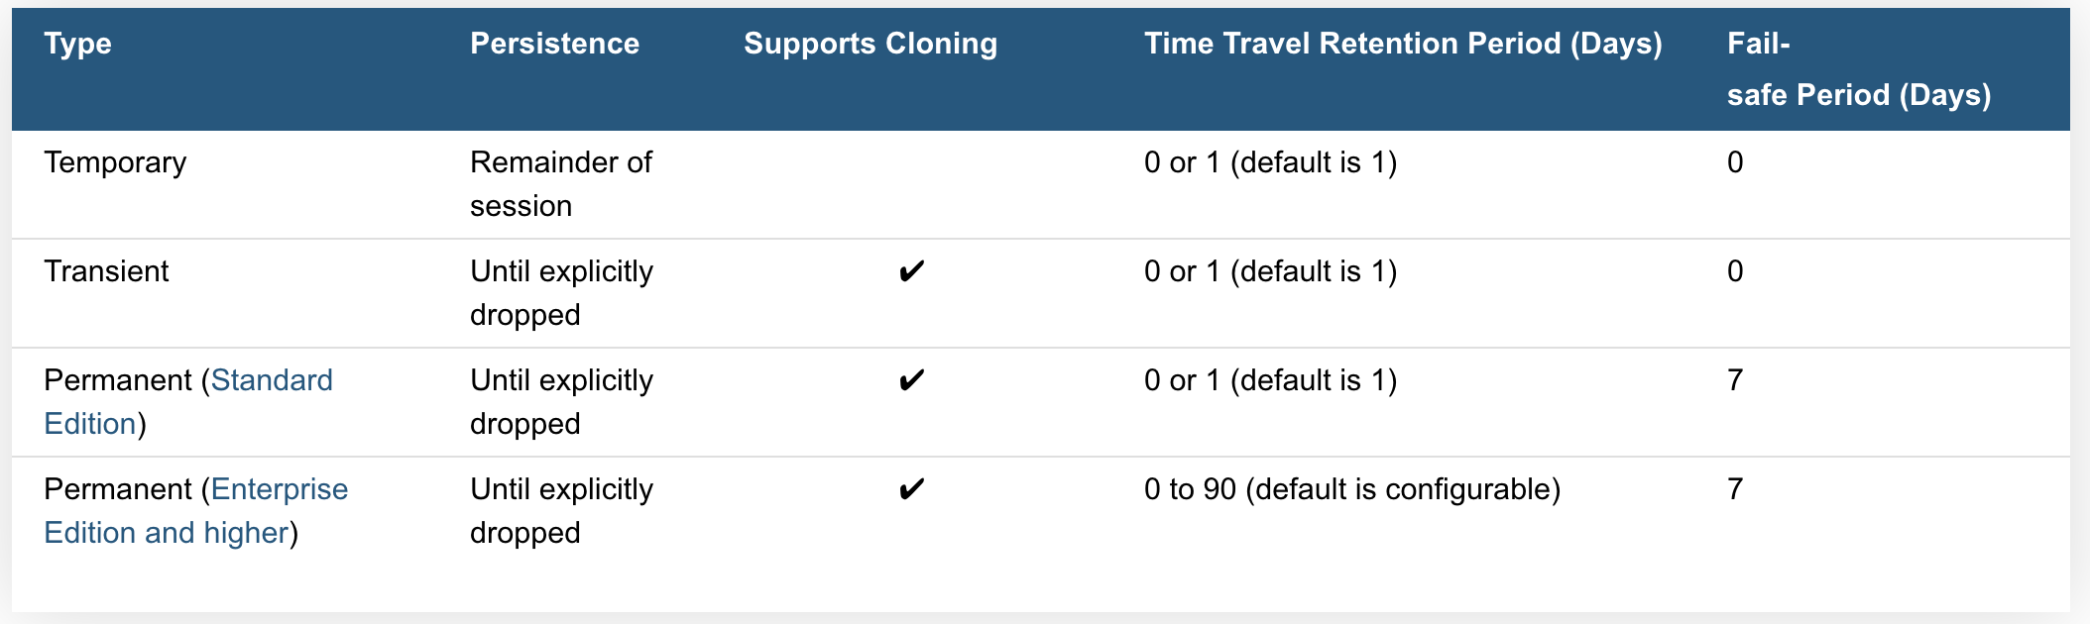
Working with Temp tables and Transient tables
Temporary Tables only exist within the session in which they were created. Once the session ends, data stored in the table is purged completely from the system
Transient Tables persist until explicitly dropped and are available to all users with the appropriate privileges. Transient tables are like permanent tables with the key difference that they do not have a Fail-safe period.
Notes:
Temp tables
transitory data (e.g. ETL data, session-specific data)
they are not visible to other users or sessions and do not support some standard features such as cloning.
is not recoverable, either by the user who created the table or Snowflake.
the data stored in the table contributes to the overall storage charges that Snowflake bills your account
Transient Tables
transient tables are specifically designed for transitory data that needs to be maintained beyond each session (in contrast to temporary tables), but does not need the same level of data protection and recovery provided by permanent tables.
Transient Databases and Schemas
Snowflake also supports creating transient databases and schemas. All tables created in a transient schema, as well as all schemas created in a transient database, are transient by definition.
Time Travel Notes
The Time Travel retention period for a table can be specified when the table is created or any time afterwards. Within the retention period, all Time Travel operations can be performed on data in the table (e.g. queries) and the table itself (e.g. cloning and restoration).
Temporary tables can have a Time Travel retention period of 1 day; however, a temporary table is purged once the session (in which the table was created) ends so the actual retention period is for 24 hours or the remainder of the session, whichever is shorter.
Fail-safe Notes
The Fail-safe period is not configurable for any table type.
Transient and temporary tables have no Fail-safe period. As a result, no additional data storage charges are incurred beyond the Time Travel retention period.

Slide 17
Working with Temp tables and Transient tables
Creating Temporary Tables simply specify the TEMPORARY keyword (or TEMP abbreviation) in CREATE TABLE
Creating Transient Tables, schemas, or databases are done by simply specifying the TRANSIENT keyword when creating the object:
create temporary table mytemptable (id number, creation_date date);
create transient table mytranstable (id number, creation_date date);
After creation, temporary and transient tables cannot be converted to any other table type
Notes:
transitory data (e.g. ETL data, session-specific data)
they are not visible to other users or sessions and do not support some standard features such as cloning.
is not recoverable, either by the user who created the table or Snowflake.
the data stored in the table contributes to the overall storage charges that Snowflake bills your account

Slide 18
Non-Materialized Views vs Materialized Views
Views usually refer to Non-Materialized Views
basically a named definition of a query
results are not stored for future use
Materialized views are named as though it were a type of view
Behave more like a table
Results are stored
Works well with unchanged base tables
Optimizes external tables
View has less rows than base table or
calculated field
CREATE [ OR REPLACE ] [ SECURE ]
MATERIALIZED VIEW [ IF NOT EXISTS ] <name> [ COPY GRANTS ] ( <column_list> ) [ COMMENT = '<string_literal>' ] [ CLUSTER BY ( <expr1> [, <expr2>
... ] ) ] AS <select_statement>
Notes:
Non materialized view
Selecting some (or all) columns in a table.
Selecting a specific range of data in table columns.
Joining data from two or more tables
Materialized views are designed to improve query performance for workloads composed of common, repeated query patterns. However, materializing intermediate results incurs additional costs. As such, before creating any materialized views, you should consider whether the costs are offset by the savings from re-using these results frequently enough.
Query results contain a small number of rows and/or columns relative to the base table (the table on which the view is defined).
Query results contain results that require significant processing, including:
Analysis of semi-structured data.
Aggregates that take a long time to calculate.
The query is on an external table (i.e. data sets stored in files in an external stage), which might have slower performance compared to querying native database tables.

Slide 19


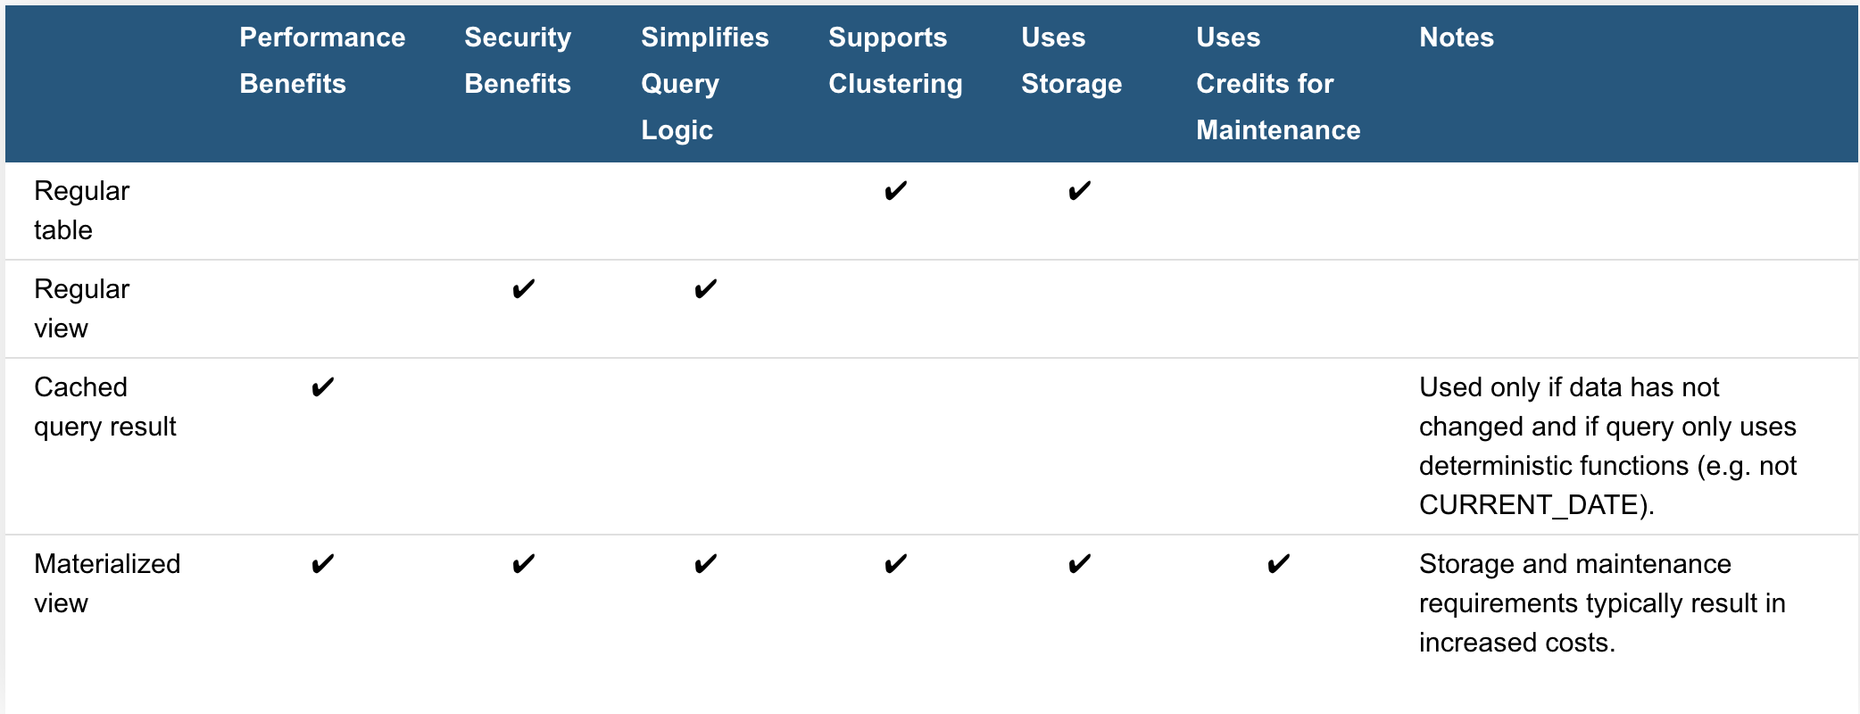
Advantages of Views
Secured views provide improved data privacy and data sharing
Both non-materialized and materialized views can be defined as secure
Views enable writing more modular code
Views allow you to grant access to just a portion of the data in a table(s)
Provide privileges based on data in each view
Views can improve performance
Notes:
Two use cases of modular code
suppose that your hospital database has a table listing information about all employees.
You can create views to make it convenient to extract information about only the medical staff or only the maintenance staff. You can even create hierarchies of views.
rather than writing one large and difficult-to-understand query, you can decompose the query into smaller pieces, and create a view for each of those pieces
Limitations on Views
The definition for a view cannot be updated (i.e. you cannot use ALTER VIEW or ALTER MATERIALIZED VIEW to change the definition of a view). To change a view definition, you must recreate the view with the new definition.
Changes to a table are not automatically propagated to views created on that table. For example, if you drop a column in a table, the views on that table might become invalid.
Views are read-only (i.e. you cannot execute DML commands directly on a view). However, you can use a view in a subquery within a DML statement that updates the underlying base table

Slide 20




Table Design Considerations
Date/Time Data Types for Columns
Use a date and timestamp value rather than a varchar
Referential Integrity Constraints
Other than not null are added but do not actually do anything in Snowflake
When to Set a Clustering Key
Loaded data does not match how it is queried
Query Profile shows excessive table scan time
Notes:
Date and time
When defining columns to contain dates or timestamps, we recommend choosing a date or timestamp data type rather than a character data type. Snowflake stores DATE and TIMESTAMP data more efficiently than VARCHAR, resulting in better query performance
Referential integrity constraints
in Snowflake are informational and, with the exception of NOT NULL, not enforced. Constraints other than NOT NULL are created as disabled.
However, constraints provide valuable metadata. The primary keys and foreign keys enable members of your project team to orient themselves to the schema design and familiarize themselves with how the tables relate with one another.
When to add a clustering key
The order in which the data is loaded does not match the dimension by which it is most commonly queried (e.g. the data is loaded by date, but reports filter the data by ID). If your existing scripts or reports query the data by both date and ID (and potentially a third or fourth column), you may see some performance improvement by creating a multi-column clustering key.
Query Profile indicates that a significant percentage of the total duration time for typical queries against the table is spent scanning. This applies to queries that filter on one or more specific columns.

Slide 21

Table Design Considerations continued
When to Specify Column Lengths
When it is predictable otherwise Snowflake automatically optimizes it
Storing Semi-structured Data in a VARIANT Column vs. Flattening the Nested Structure
It is better to flatten objects if it is known how you will be using the columns
Converting a Permanent Table to a Transient Table or Vice-Versa
It is impossible to change a permanent table to a transient
It can be cloned
Notes:
Column size
Snowflake compresses column data effectively; therefore, creating columns larger than necessary has minimal impact on the size of data tables. Likewise, there is no query performance difference between a column with a maximum length declaration (e.g. VARCHAR(16777216)), and a smaller precision.
column data is predictable, define an appropriate column length
Data loading operations are more likely to detect issues such as columns loaded out of order
Unspecified lengths cause some third-party tools may anticipate consuming the maximum size value, which can translate into increased client-side memory usage or unusual behavior.
For better pruning and less storage consumption, we recommend flattening your object and key data into separate relational columns if your semi-structured data includes:
Dates and timestamps, especially non-ISO 8601 dates and timestamps, as string values
Numbers within strings
Arrays
Currently, it isn’t possible to change a permanent table to a transient table using the ALTER TABLE command. The TRANSIENT property is set at table creation and cannot be modified.
Similarly, it isn’t possible to directly change a transient table to a permanent table.
To convert an existing permanent table to a transient table (or vice versa) while preserving data and other characteristics such as column defaults and granted privileges, you can create a new table and use the COPY GRANTS clause, then copy the data:

Slide 22
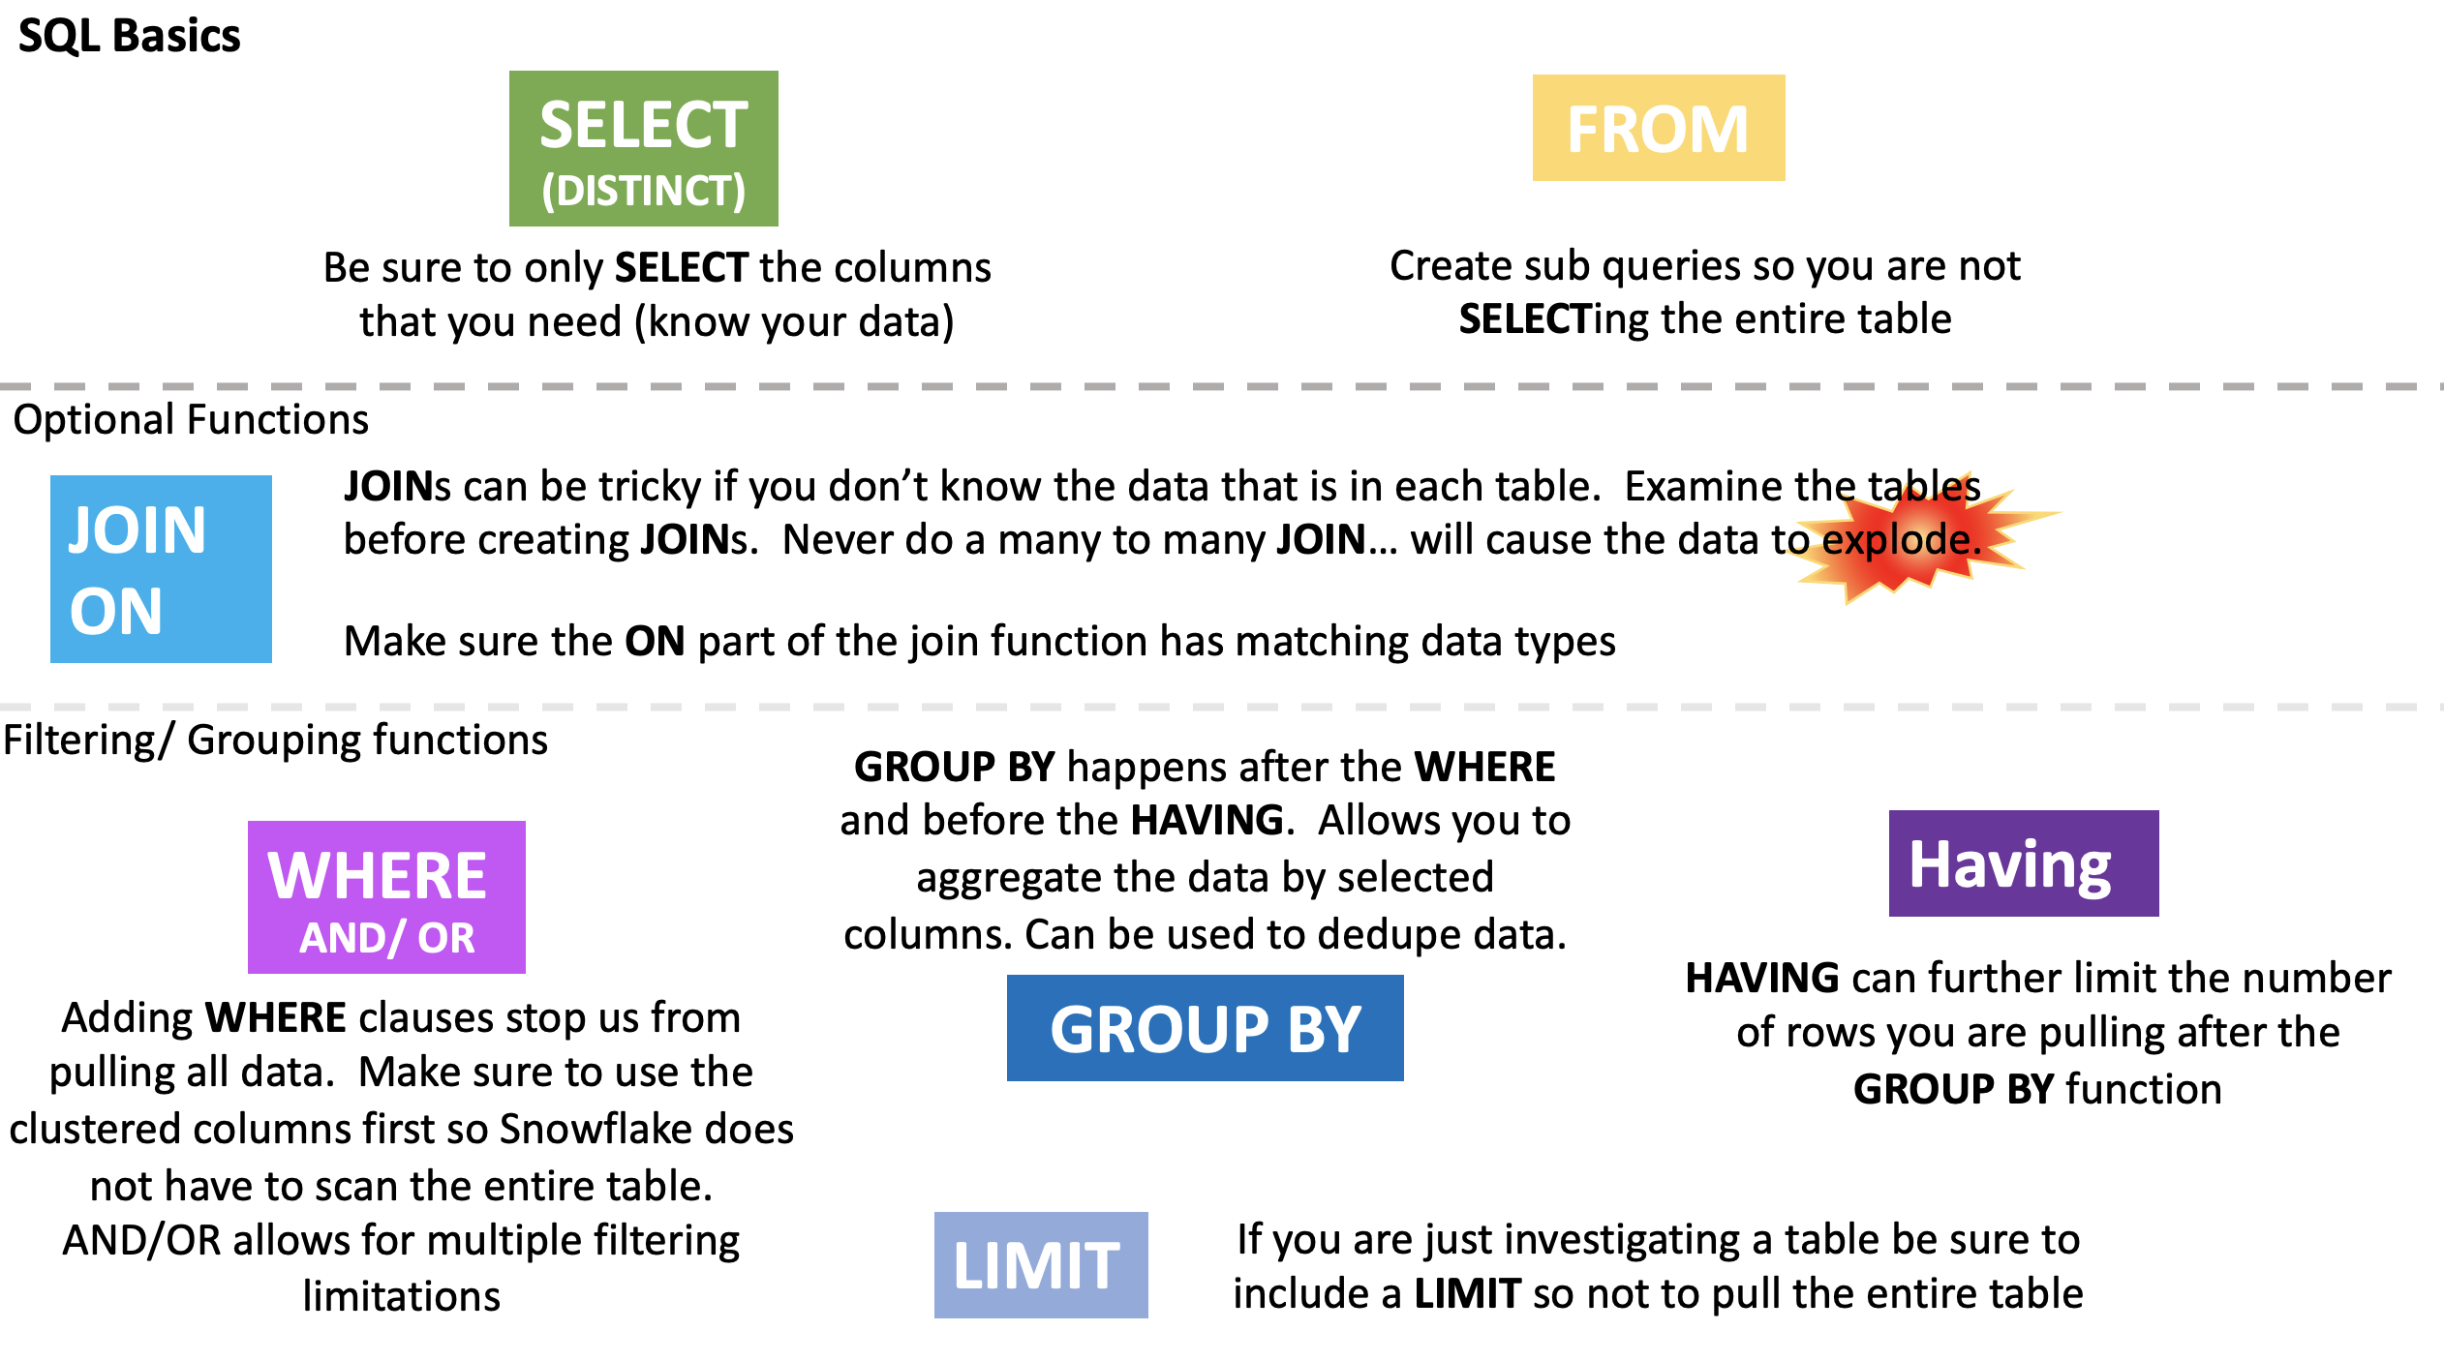

Slide 23
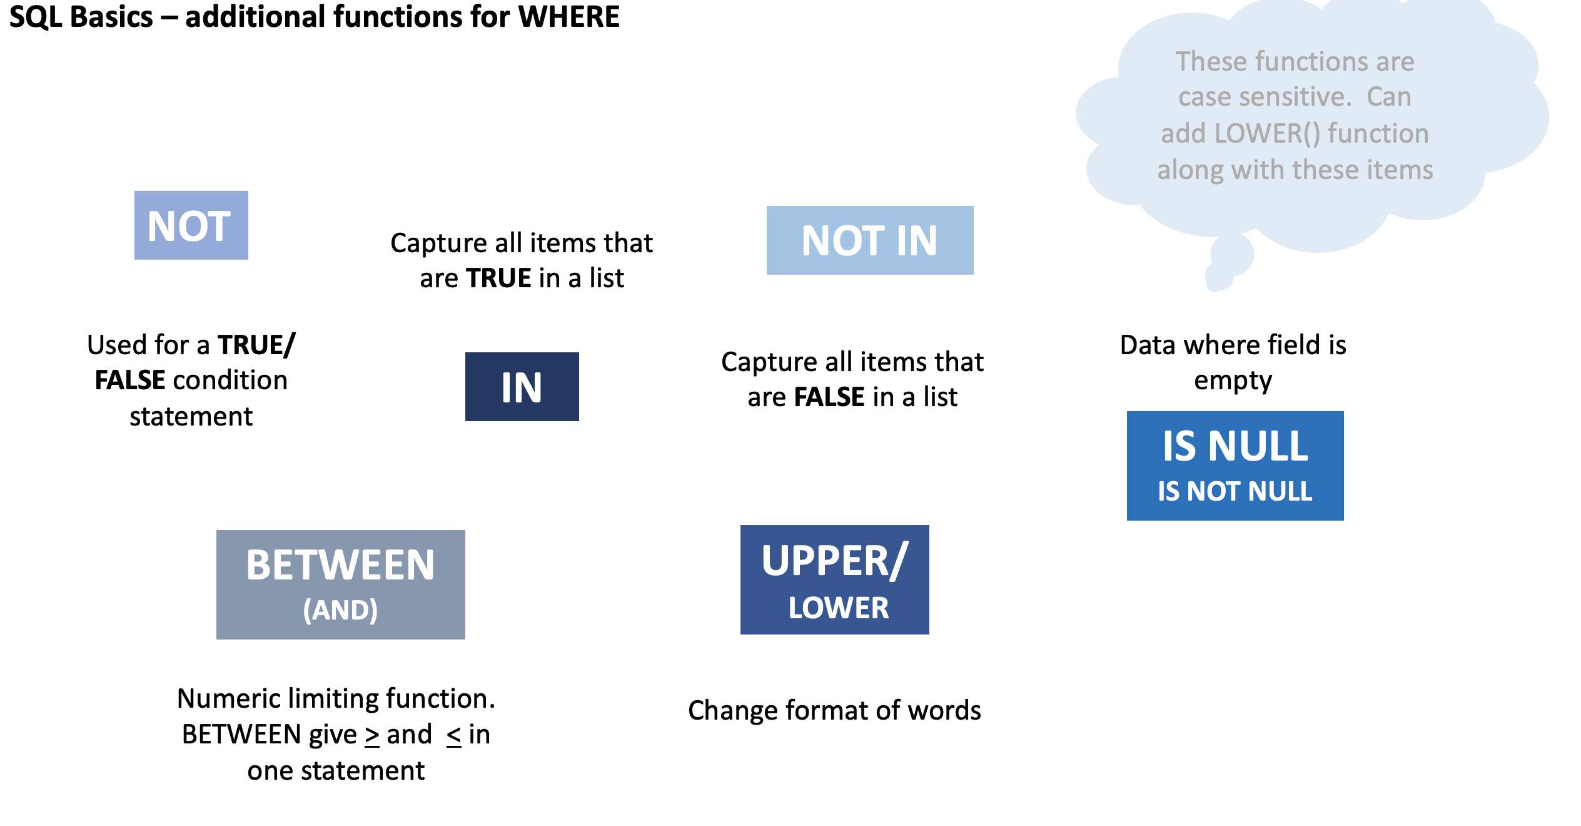

Slide 24
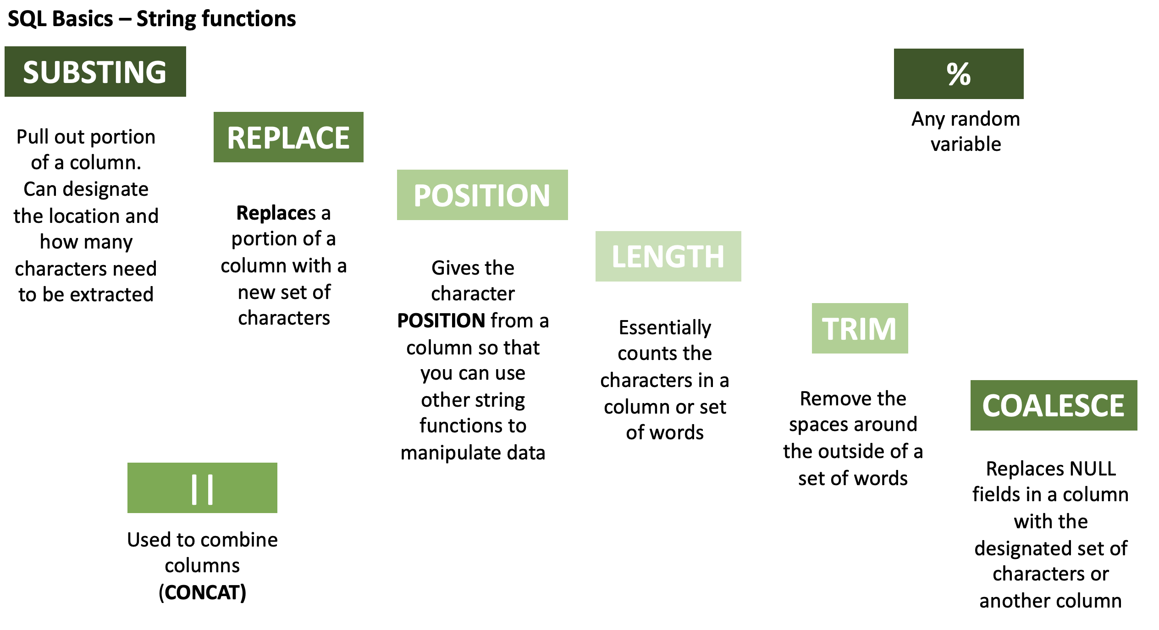

Slide 25
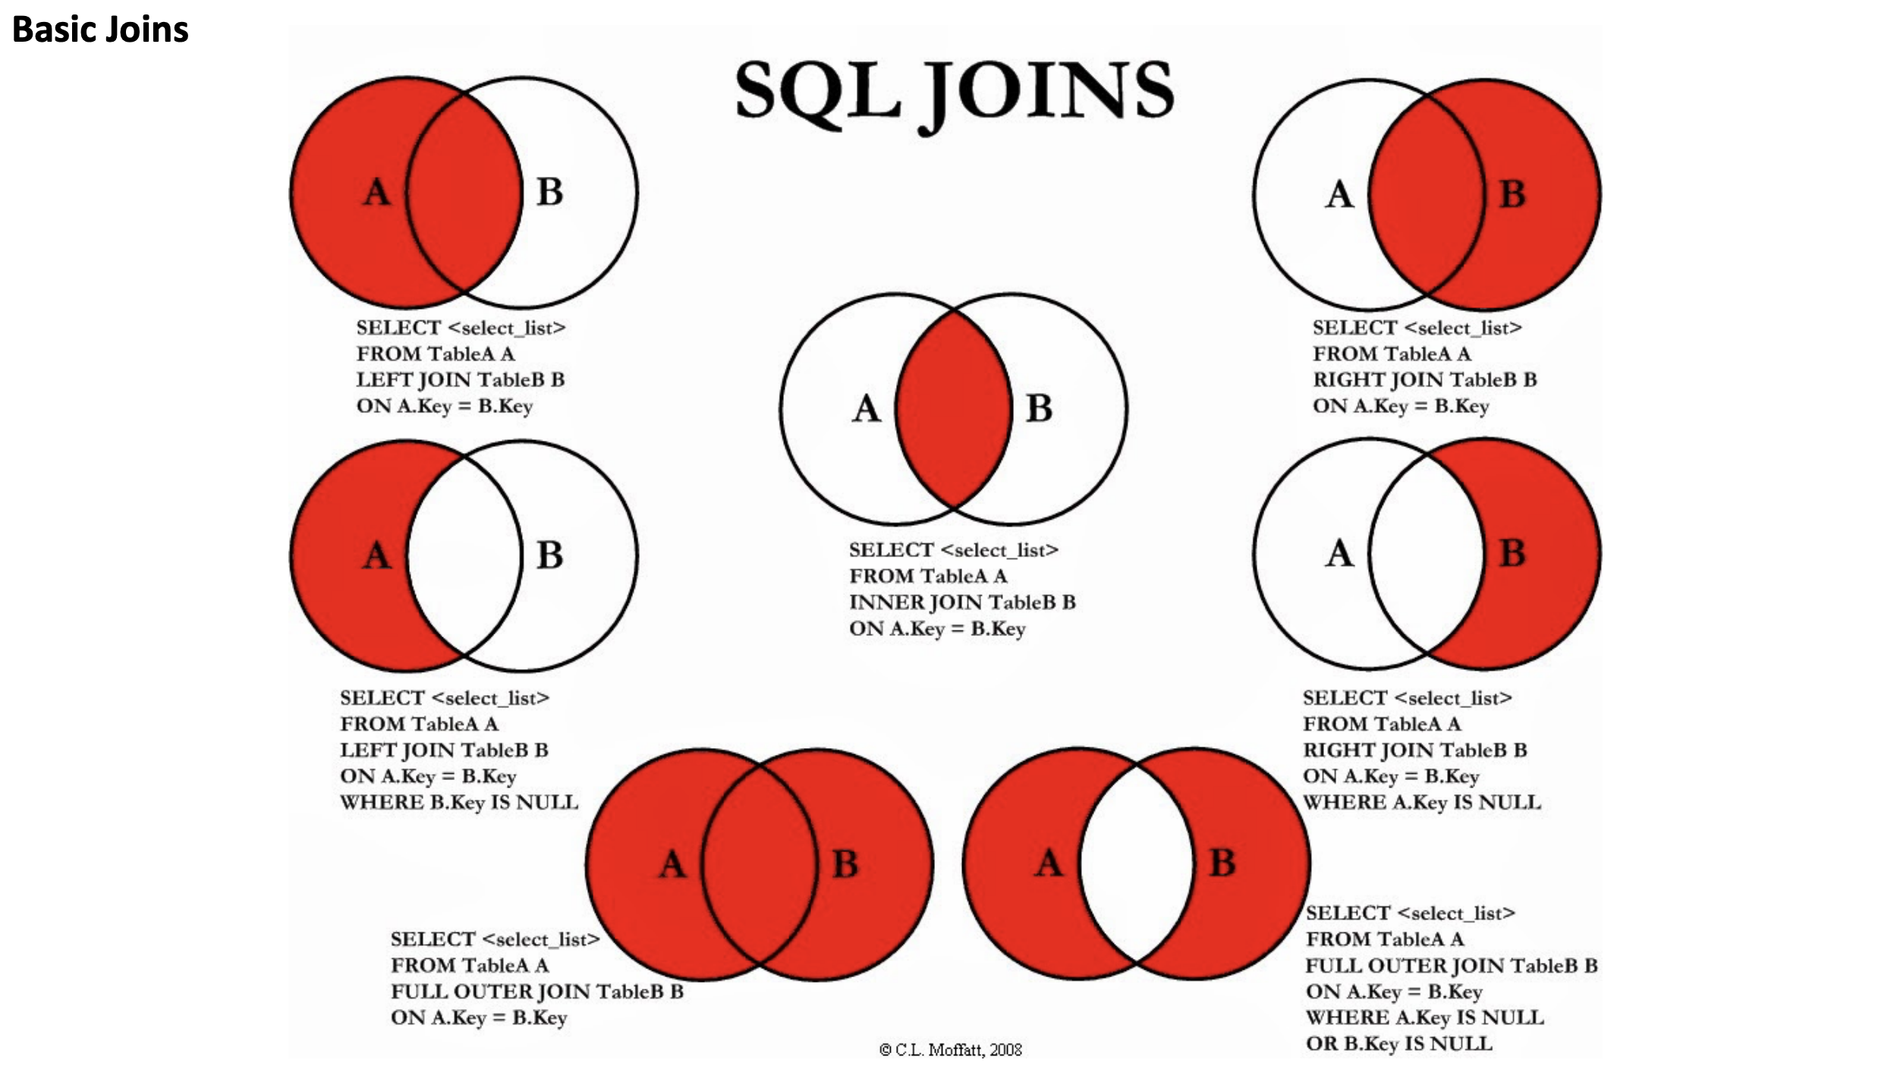

Slide 26


Subqueries
Correlated vs Uncorrelated
Correlated refers to one or more columns from outside of the subquery
Uncorrelated has no such external column references. It is an independent query
Scalar vs Non-Scalar
Scalar subquery returns a single value (one column of one row)
Non-Scalar subquery returns 0 to multiple rows, each of which may contain 1 to multiple columns
SELECT p.name, p.annual_wage, p.country
FROM pay as p WHERE p.annual_wage <
(SELECT max(per_capita_gdp) FROM international_gdp i WHERE p.country = i.name);
SELECT c1, c2 FROM table1
WHERE c1 =
(SELECT max(x) FROM table2);
SELECT p.name, p.annual_wage, p.country FROM pay as p WHERE p.annual_wage < (SELECT per_capita_gdp FROM international_gdp WHERE name = 'Brazil');
Notes:
-- Uncorrelated subquery: select c1, c2 from table1 where c1 = (select max(x) from table2); -- Correlated subquery: select c1, c2 from table1 where c1 = (select x from table2 where y = table1.c2);
uncorrelated subquery in a where clause. The subquery gets the per capita GDP of Brazil, and the outer query selects all the jobs (in any country) that pay less than the per-capita GDP of Brazil.
The subquery is uncorrelated because the value that it returns does not depend upon any column of the outer query.
The subquery only needs to be called once during the entire execution of the outer query.
Uncorrelated - select p.name, p.annual_wage, p.country from pay as p where p.annual_wage < (select per_capita_gdp from international_gdp where name = 'Brazil’);
correlated subquery in a where clause. The query lists jobs where the annual pay of the job is less than the per-capita GDP in that country.
This subquery is correlated because it is called once for each row in the outer query and is passed a value, p.country (country name), from the row.
Correlated sub query - select p.name, p.annual_wage, p.country from pay as p where p.annual_wage < (select max(per_capita_gdp) from international_gdp i where p.country = i.name);

Slide 27
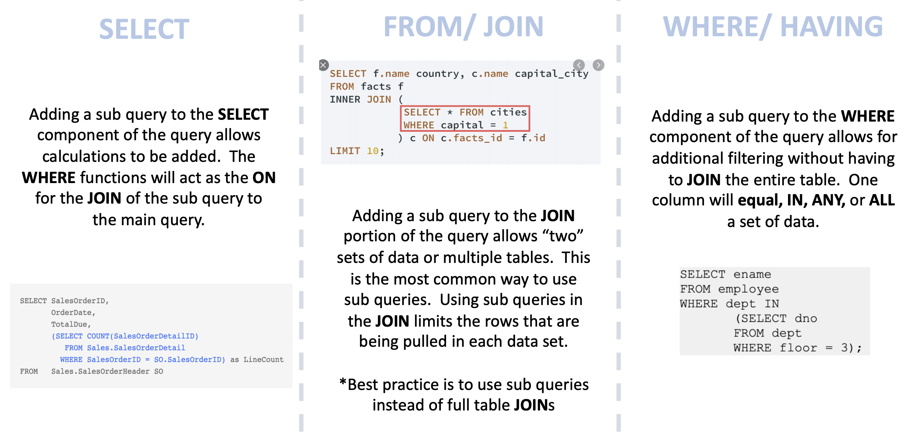
Subqueries – Where can they be used
Notes:
Where can you put subqueries ( use slide I created for SQL class)
Subquery operators operate on nested query expressions. They can be used to compute values that are:
Returned in a SELECT list.
Grouped in a GROUP BY clause.
Compared with other expressions in the WHERE or HAVING clause
Limitations
Although subqueries can contain a wide range of SELECT statements, they have the following limitations:
Some clauses are not allowed inside of ANY/ALL/NOT EXISTS subqueries.
The only type of subquery that allows a LIMIT / FETCH clause is an uncorrelated scalar subquery. Also, because an uncorrelated scalar subquery returns only 1 row, the LIMIT clause has little or no practical value inside a subquery.

Slide 28

Common Table Expressions (CTE)s
A CTE (common table expression) is a named subquery defined in a WITH clause
think of the CTE as a temporary view
Non-Recursive – CTE does not reference itself
Will need two-level join for hierarchal data
Recursive - CTE that references itself
Think self joins on hierarchal data
Can create multiple joins without know how many levels are left
select emps.title, emps.employee_id, mgrs.employee_id as manager_id, mgrs.title as "MANAGER TITLE"
from employees as emps
left outer join employees as mgrs
on emps.manager_id = mgrs.employee_id
order by mgrs.employee_id nulls first,
emps.employee_id;
WITH [ RECURSIVE ] <cte_name>
AS
( <anchor_clause>
UNION ALL
<recursive_clause> )
SELECT ... FROM ...;
Notes:
Recursive CTE Considerations
Potential for Infinite Loops
In theory, constructing a recursive CTE incorrectly can cause an infinite loop. In practice, Snowflake prevents this by limiting the number of iterations that the recursive clause will perform in a single query. The MAX_RECURSIONS parameter limits the number of iterations.
To change MAX_RECURSIONS for your account, please contact Snowflake Support.
More Hierarchal data
In a two-level hierarchy (for example, managers and employees), the data can be queried with a two-way join
In a three-level hierarchy, you can use a 3-way join:
This concept can be extended to as many levels as needed, as long as you know how many levels are needed. But if the number of levels changes, the queries need to change.
Can also use connect by along with recursive CTEs

Slide 29
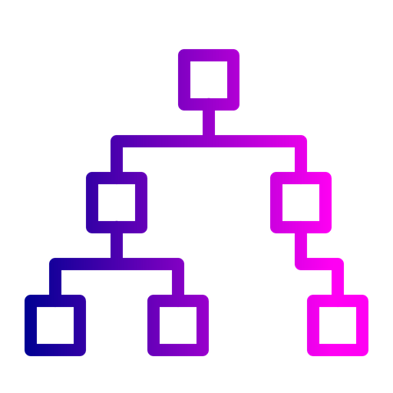
Hierarchal Data - Recursive CTE example
-- This is the WITH clause, of course.
with recursive managers
-- Column names for the "view"/CTE
(indent, employee_id, manager_id, employee_title)
as
-- Common Table Expression
( -- Anchor Clause
select '' as indent, employee_id, manager_id, title as employee_title
from employees
where title = 'President’
union all
-- Recursive Clause
select indent || '--- ‘,
employees.employee_id, employees.manager_id, employees.title
from employees
join managers
on employees.manager_id = managers.employee_id ) -- This is the "main select".
select indent || employee_title as title, employee_id, manager_id
from managers ;

Slide 30
More Advanced querying
Querying semi structured data
Arrays allow data to be stored that is not used regularly
Arrays can be flattened if it needs to be accessed
Example of an array:
Using Sequences
Sequences are used to generate unique numbers across sessions and statements, including concurrent statements.
They can be used to generate values for a primary key or any column that requires a unique value
select vm.value:make::string as make, vm.value:model::string as model, ve.value::string as "Extras Purchased" from car_sales , lateral flatten(input => src:vehicle) vm , lateral flatten(input => vm.value:extras) ve;
"vehicle" : [ {"make": "Toyota", "model": "Camry", "year": "2017", "price": "23500", "extras":["ext warranty", "rust proofing", "fabric protection"]}
Notes:
Example of an array "vehicle" : [ {"make": "Toyota", "model": "Camry", "year": "2017", "price": "23500", "extras":["ext warranty", "rust proofing", "fabric protection"]}
Snowflake sequences currently utilize the following semantics:
All values generated by a sequence are globally unique as long as the sign of the sequence interval does not change. Concurrent queries never observe the same value, and values within a single query are always distinct.

Slide 31

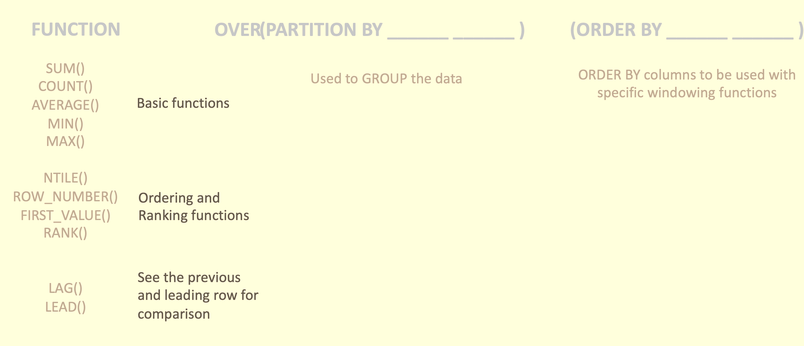

Windowing functions
Window functions operate on groups of rows that are related (e.g. by date or location). Snowflake supports:
General window functions.
Window functions that calculate rank (e.g. highest, second-highest, etc.)
Window functions that support cumulative window frames and sliding window frames
... OVER ( [ PARTITION BY <expr1> ] [ ORDER BY <expr2> [ { cumulativeFrame | slidingFrame } ] ] ) ...

Slide 32
Estimating Approximate Values
Estimating Values
Snowflake uses the Space-Saving algorithm, a space and time efficient way of estimating approximate frequent values in data sets
Snowflake uses the t-Digest algorithm, a space and time efficient way of estimating approximate percentile values in data sets.

Slide 33
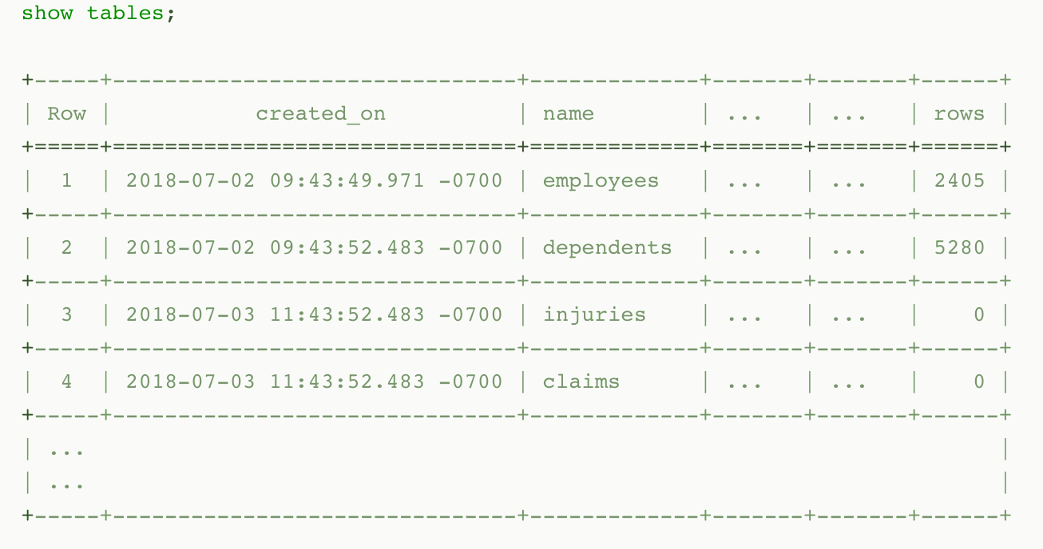
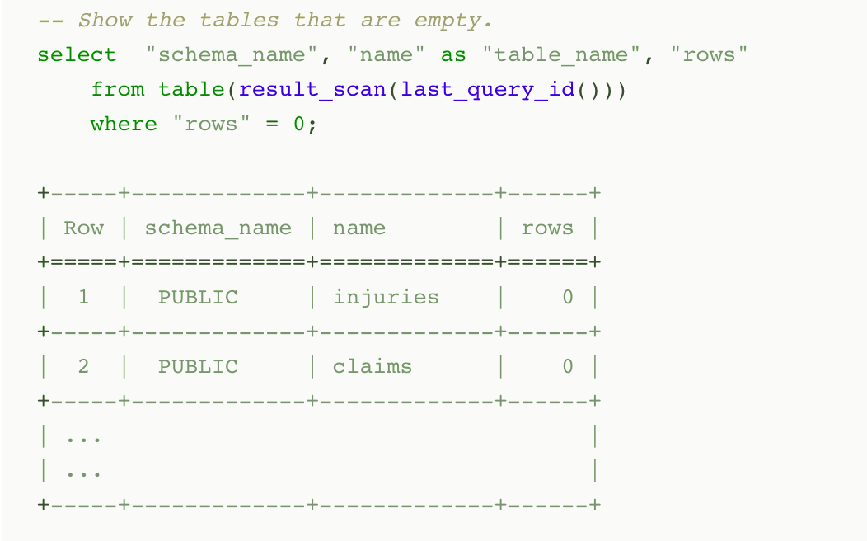
Persisted Query Results
When a query is executed, the result is persisted (i.e. cached) for a period (currently 24 hours). At the end of the time period, the result is purged from the system
Snowflake uses persisted query results to avoid re-generating results when nothing has changed
you can perform further processing on the result of a query that you’ve already run
Notes:
Typically, query results are reused if all of the following conditions are met:
The new query syntactically matches the previously-executed query.
The table data contributing to the query result has not changed.
The persisted result for the previous query is still available.
The role accessing the cached results has the required privileges If the query was a SELECT query, the role executing the query must have the necessary access privileges for all the tables used in the cached query.If the query was a SHOW query, the role executing the query must match the role that generated the cached results.
Any configuration options that affect how the result was produced have not changed.
The query does not include functions that must be evaluated at execution time, e.g. CURRENT_TIMESTAMP and UUID_STRING. (Note that the the CURRENT_DATE() function is an exception to this rule; even though CURRENT_DATE() is evaluated at execution time, queries that use CURRENT_DATE() can still use the query reuse feature.)
The table’s micro-partitions have not changed (e.g. been reclustered or consolidated) due to changes to other data in the table.

Slide 34

Query Profile to Analyze Queries
Query Profile
QP is a powerful tool for understanding the mechanics of queries
It can be used whenever you want or need to know more about the performance or behavior of a particular query
It is designed to help you spot typical mistakes in SQL query expressions to identify potential performance bottlenecks and improvement opportunities
Data Processing Operators
Filter
Join
Aggregate
Grouping Sets
Window Function
Sort / Sort with Limit
Flatten
Join Filter
Union All
Data Access and Generation Operators
Table Scan
Values Clause
Generator
External Scan
Internal Object
DML Operators
Insert
Delete
Update
Merge
Unload
Notes:
TableScan Represents access to a single table. Attributes:
Full table name — the name of the accessed table, including database and schema.
Columns — list of scanned columns
Table alias — used table alias, if present
Extracted Variant paths — list of paths extracted from VARIANT columns
ValuesClause List of values provided with the VALUES clause. Attributes:
Number of values — the number of produced values.
Values — the list of produced values.
Generator Generates records using the TABLE(GENERATOR(...)) construct. Attributes:
rowCount — provided rowCount parameter.
timeLimit — provided timeLimit parameter.
ExternalScan Represents access to data stored in stage objects. Can be a part of queries that scan data from stages directly, but also for data-loading COPY queries. Attributes:
Stage name — the name of the stage where the data is read from.
Stage type — the type of the stage (e.g. TABLE STAGE).
InternalObject Represents access to an internal data object (e.g. an Information Schema table or the result of a previous query). Attributes:
Object Name — the name or type of the accessed object.
Data Processing Operators
Filter Represents an operation that filters the records. Attributes:
Filter condition - the condition used to perform filtering.
Join Combines two inputs on a given condition. Attributes:
Join Type — Type of join (e.g. INNER, LEFT OUTER, etc.).
Equality Join Condition — for joins which use equality-based conditions, it lists the expressions used for joining elements.
Additional Join Condition — some joins use conditions containing non-equality based predicates. They are listed here.
Aggregate Groups input and computes aggregate functions. Can represent SQL constructs such as GROUP BY, as well as SELECT DISTINCT. Attributes:
Grouping Keys — if GROUP BY is used, this lists the expressions we group by.
Aggregate Functions — list of functions computed for each aggregate group, e.g. SUM.
GroupingSets Represents constructs such as GROUPING SETS, ROLLUP and CUBE. Attributes:
Grouping Key Sets — list of grouping sets
Aggregate Functions — list of functions computed for each group, e.g. SUM.
WindowFunction Computes window functions. Attributes:
Window Functions — list of window functions computed.
Sort Orders input on a given expression. Attributes:
Sort keys — expression defining the sorting order.
SortWithLimit Produces a part of the input sequence after sorting, typically a result of an ORDER BY ... LIMIT ... OFFSET ... construct in SQL. Attributes:
Sort keys — expression defining the sorting order.
Number of rows — number of rows produced.
Offset — position in the ordered sequence from which produced tuples are emitted.
Flatten Processes VARIANT records, possibly flattening them on a specified path. Attributes:
input — the input expression used to flatten the data.
JoinFilter Special filtering operation that removes tuples that can be identified as not possibly matching the condition of a Join further in the query plan. Attributes:
Original join ID — the join used to identify tuples that can be filtered out.
UnionAll Concatenates two inputs. Attributes: none.
DML Operators
Insert Adds records to a table either through an INSERT or COPY operation. Attributes:
Input expressions — which expressions are inserted.
Table names — names of tables that records are added to.
Delete Removes records from a table. Attributes:
Table name — the name of the table that records are deleted from.
Update Updates records in a table. Attributes:
Table name — the name of the updated table.
Merge Performs a MERGE operation on a table. Attributes:
Full table name — the name of the updated table.
Unload Represents a COPY operation that exports data from a table into a file in a stage. Attributes:
Location - the name of the stage where the data is saved.

Slide 35
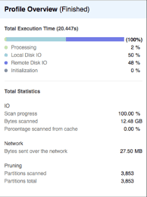
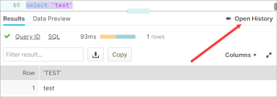
Query Profile
Powerful tool for understanding the mechanics of queries
Identify potential performance bottlenecks
Available through the web interface
Provides a graphical representation of the main components of processing plan for the query
Provides statistics and details of the overall query
Notes:
We will circle back to this later today but good to take a look at it now

Slide 36
Query Profile

Slide 37
Estimating with HyperLogLog (HLL)
HyperLogLog is used to estimate the approximate number of distinct values in a data set
HLL can be used in place of COUNT(DISTINCT …) in situations where estimating cardinality is acceptable
HLL Returns an approximate distinct cardinality of the input
HLL_ACCUMULATE Skips the final estimation step and returns the HLL state at the end of an aggregation.
HLL_COMBINE Combines (i.e. merges) input states into a single output state
HLL_ESTIMATE Computes a cardinality estimate of a HLL state produced by HLL_ACCUMULATE and HLL_COMBINE
HLL_EXPORT Converts HLL states from BINARY format to an OBJECT (which can then be printed and exported as JSON).
HLL_IMPORT Converts HLL states from OBJECT format to BINARY format
Notes:
HyperLogLog implementation is 1.62338% (i.e. the average relative difference to the corresponding COUNT(DISTINCT …)

Slide 38
Oracle vs Snowflake
Feature | Oracle | Snowflake
Workload | Transactional or Data Warehouse (OLTP or OLAP) | Pure Data Warehouse (OLAP only)
Deployed | On Premise | On the Public Cloud (AWS, Azure and GCP)
Cost | Fixed Charge - per user and per CPU (can have significant upfront costs) | Flexible charging – pay only for consumption (min charge 60 sec. No hardware costs)
High Availability and Disaster Recovery | Real Application Clusters and a standby database. (can be very expensive) | Data is automatically replicated to 3 zones without additional cost.
Options to Scale | Fixed. Only able to deploy a bigger machine or add hardware to a RAC cluster | 8 levels of scaling from XS -> 4XL Plus you can also implement auto scaling Only pay for the compute resources used.
Option to Scale out (ie more users) | Again there is a fixed cost as seen above | Automatic scale out built in with up to 10X the number of users. Additional resources are added and removed and you only pay for the resources used.
Upgrades and Patches | Patches release on a regular schedule and must be installed by the customer on each DB | Automatically done and transparently applied
Management overhead | Highly complex DB platform that usually needs at least one DBA | Don’t need one other than to help monitor costs of storage
Partitions and indexes | Manually defined partitions and sub-partitions 14 types of indexes – with significant system overhead | Automatic partitions Zero – snowflake implements automatic partitions

